Slide 1
Honey C-4
VR Concept Document

Slide 2
Game Description
What is it?

Slide 3
Quick SUMMARY
Educational spy adventure virtual reality (VR) game
Focused on programming basics as well as a sprinkle of cybersecurity concepts

Slide 4
Design Goals & Values
Enhance learning of coding and other STEM fields using Virtual Reality and embodied learning
Inspire users’ creativity and curiosity to delve deeper in coding and other related fields
Teach coding in a fun and interactive way and encourage lateral thinking
Be the first VR educational app that deviates from the fieldtrip / expedition genre mostly using 360° photos and videos

Slide 5
Business & Marketing

Slide 6
Target Audience
Primary Audience
Teens (13 - 17) and Young Adult (18 - 25)
Anyone who is interested in learning the basics of coding

Slide 7
Gaming Platform & Distribution
Pilot
Mobile VR Game
Initially available on Android and iOS via Play Store and App Store respectively
Headset: Google Cardboard (or similar)
Ideal for Primary Audience
Future (Dependent on Pilot)
Room-Scale Game
Available on Steam for PC
For Oculus Rift and HTC Vive

Slide 8
Ideal Player Experience
Should a fun, learning environment
Should be comfortable viewing the game
Builds player’s confidence through positive reinforcement
Helps the user to develop problem-solving skills as there are different ways to approach a problem / challenge

Slide 9

Business Model
Hybrid
Freemium
Offer the app for free but allows users to make a one-time purchase to unlock features
Partnership with a sponsor
Referral codes to unlock some behind-the-scenes concept art and products/services offered by partner

Slide 10
Game Design

Slide 11

Main Storyline
User plays as Agent Thursday – the newest addition of the Coding Higher Intelligence Logistics Division (commonly known as Team CHILD) at the SMART Spy Agency
Fellow CHILD operatives have been captured at their last known location: an undisclosed HoneyGlobe International Data Tower deep in the GIGO Jungle.
User must complete all tasks, get past all the techy booby-traps and defeat operatives from the enemy organization VVAN

Slide 12
Style Guide

Slide 13

Visual Style #1
Minimalistic visual style like the one seen in Land’s End
Land’s End is a VR adventure game by the creators of Monument Valley
Available for the Samsung Gear

Slide 14
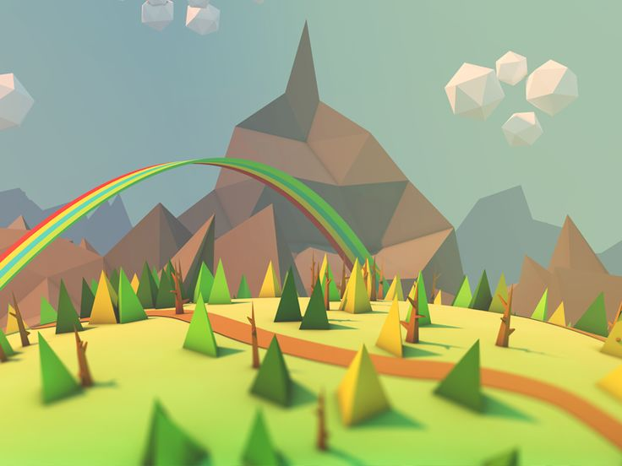
Visual Style #2
Low Poly Art Style
Simpler design (great for beginners)
Computationally less expensive on processor versus high resolution rendering

